Slide 1

MOS TOKEN

Slide 2

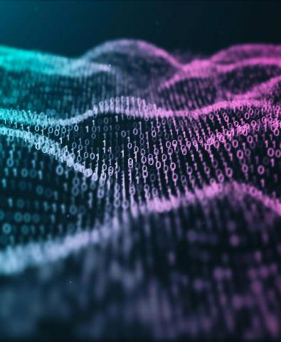
INTRODUCTION
The untamed wilderness of our future is projects built on the foundation of community involvement. We become free to seek new methods to handle problems and relate to one another as we move away from inflexible social structures and traditional attitudes.
Community-based projects are more than just a change of pace in a society where time is commodified; they are a way to exercise radical acceptance of others. We are forced to alter our perspectives to match with those around us when success depends on the aggregate power of the individuals who make up a collective. MOS TOKEN Ecosystem is our way of recognizing the need of deconstructing a long-held paradigm of formulaic success and replacing it with a route to freedom and creativity.

Slide 3

ABOUT US
The entire MOS, decided to prove our existence, starting with a digital currency and progressing to a central trading platform, because digital currencies have demonstrated that our direction is a bright future and the ease of moving our money away from the usual methods that carry procedures and complexity. You can trade in any digital currency while maintaining complete control over your funds. Mos will be the principal currency of our future world. Also, from our future platform, you can withdraw your money from most international banks and electronic platforms.

Slide 4
Our background
We began at the beginning, with zero. Our project's spirit is to make something out of nothing. We didn't start with a pre-existing community or a pre-assembled team. MOS' bright minds have never worked together before. It was a new group of programmers, designers, moderators, marketers, and shills. When you joined the MOS army, you could join from anywhere in the world and immediately put your skills to use.

Slide 5
Why Decentralization?
subtitle
We are at a crossroads in terms of innovation . All of our official structures have required centralization up until now. Political, educational, and financial systems are, and have always been, designed in such a way that power is not distributed evenly and ethically among those who operate within them. This type of internal design may have been necessary at times in history, but in an age where the entire world's knowledge is available at the touch of a button, it's time to reconsider .When the stock values of GameStop and AMC exploded virtually overnight in 2021, it showed how little influence the average person has in the face of these broad, generational organizations. WallStreetBets experimented with what it may look like.

Slide 6
WHY ETH
When examining alternative blockchains, you might be wondering why we stuck with the Ethereum network. Like the rest of our project, the solution is basic and meaningful . Our founder, Ryoshi, started the MOS adventure with an interest in Ethereum. It's already safe and reliable, and it enables us to remain decentralized (unlike some of the "fad" networks).His greatest objective was to ensure that his project could adapt and evolve without being hampered by outside regulations, and ETH was the means to that end . Our army can keep their own tokens in a wallet and accept payments from all across the world while remaining unaffected by moderators . Our founder also made the decision to 50% of the whole supply should be given to Vitalik Buterin's wallet because, in his opinion, ""We sent almost 50% of the TOTAL supply to Vitalik," he said. There is no greatness without a vulnerable point, and MOS will grow and flourish as long as VB does not rug us."

Slide 7
MosSwap.
We are committed to creating the world's best Decentralized Ecosystem (DECO). Our three tokens were the seeds that grew the Mos Inu Ecosystem, and MosSwap is how they've established themselves.
MosSwap's purpose is to provide a secure environment for trading your valuable crypto while being decentralized. We are faithful to our investors, which allows us to expand rapidly. We will continue to scale this Ecosystem in order to attract more and more people to the MosSwap platform.
.

Slide 8
MosSwap2
The platform's power will be reinforced by our unique tokenomics, excellent design, technological implementation, and viral growth from our good ol' fashion memes, which will bring residual advantages to the Ecosystem . Making a swap without a budget is a one-of-a-kind experience. We will construct a focused development team from the community by addressing multiple genres and product lines

Slide 9
Our Future
MOS owns 800 million coins. The company keeps 400 million coins distributed accurately and not randomly. You can see the picture on the front page of the official website.
MOS offers 400 million as an initial investment within the first book, which will not be thereafter. The MOS coin is the main currency of the platform that you will create under the auspices of MOS, and our partners are reticent to not monopolize the currency within the subscription, but our staff promises you to disclose large and large information after the subscription is completed completely, and the distribution of digital currencies and airdrops for the currency.(future platform) An official website for the platform will be established before the end of the subscription. Our platform will be one of the major competitors and a complete change in the course and method of trading digital currencies. It is characterized by ease of withdrawal and deposit in all foreign, Arab and even African countries. There will also be a very strong tracking and protection system to protect platform users from being robbed and so on. .MOS is glad you will have an enjoyable experience.

